Slide 1
Microsoft Azure Fundamentals
Module 3, Section 2
Dr. Tóth Ádám
toth.adam@inf.unideb.hu

Slide 2
Governance and compliance
Notes:
https://learn.microsoft.com/training/modules/describe-features-tools-azure-for-governance-compliance

Slide 3

Azure Policy
Azure Policy helps to enforce organizational standards and to assess compliance at scale. Provides governance and resource consistency with regulatory compliance, security, cost, and management.
Evaluates and identifies Azure resources that do not comply with your policies.
Provides built-in policy and initiative definitions, under categories such as Storage, Networking, Compute, Security Center, and Monitoring.
Notes:
https://learn.microsoft.com/training/modules/describe-features-tools-azure-for-governance-compliance/3-describe-purpose-of-azure-policy
Azure Policy: https://azure.microsoft.com/en-us/services/azure-policy
Stay compliant with your corporate standards and service level agreements (SLAs) by using policy definitions to enforce rules and effects for your Azure resources.
Evaluates and identifies Azure resources that don’t comply with your policies.
Provides built-in policy and initiative definitions, under categories such as Storage, Networking, Compute, Security Center, and Monitoring.
Azure Policy is a service in Azure that enables you to create, assign, and manage policies that control or audit your resources. These policies enforce different rules across all of your resource configurations so that those configurations stay compliant with corporate standards.

Slide 4
Azure Policy
Implementing a policy in Azure Policy involves these three steps:
Create a policy definition.
Assign the definition to resources.
Review the evaluation results.

Slide 5
Create a policy definition
A policy definition expresses what to evaluate and what action to take. Every policy definition has conditions under which it's enforced. A policy definition also has an accompanying effect that takes place when the conditions are met. Here are some example policy definitions:
Allowed virtual machine SKUs
Allowed locations
MFA should be enabled on accounts with write permissions on your subscription
CORS should not allow every resource to access your web applications
System updates should be installed on your machines

Slide 6
Assign the definition to resources
To implement your policy definitions, you assign definitions to resources. A policy assignment is a policy definition that takes place within a specific scope. This scope could be a management group (a collection of multiple subscriptions), a single subscription, or a resource group.
Policy assignments are inherited by all child resources within that scope.

Slide 7
Review the evaluation results
When a condition is evaluated against your existing resources, each resource is marked as compliant or noncompliant.
Policy evaluation happens about once per hour. If you make changes to your policy definition and create a policy assignment, that policy is evaluated over your resources within the hour.

Slide 8
Azure Policy initiatives
An Azure Policy initiative is a way of grouping related policies into one set. The initiative definition contains all of the policy definitions to help track your compliance state for a larger goal.
Enable Monitoring in Azure Security Center (contains over 100 separate policy definitions): to monitor all of the available security recommendations for all Azure resource types in Azure Security Center.
Under this initiative, the following policy definitions are included:
Monitor unencrypted SQL Database in Security Center
Monitor OS vulnerabilities in Security Center
Monitor missing Endpoint Protection in Security Center

Slide 9
Assign an initiative
Like a policy assignment, an initiative assignment is an initiative definition that's assigned to a specific scope of a management group, a subscription, or a resource group.
An initiative enables you to increase the number of policies over time. Because the associated initiative remains assigned, it's easier to add and remove policies without the need to change the policy assignment for your resources.

Slide 10
Resource locks
Protect your Azure resources from accidental deletion or modification.
Manage locks at subscription, resource group, or individual resource levels within the Azure portal.
Lock Types | Read | Update | Delete
Delete | Yes | Yes | No
ReadOnly | Yes | No | No
Notes:
https://learn.microsoft.com/training/modules/describe-features-tools-azure-for-governance-compliance/4-describe-purpose-of-resource-locks
Resource Locks: https://learn.microsoft.com/azure/azure-resource-manager/resource-group-lock-resources
A resource lock prevents resources from being accidentally deleted or changed.

Slide 11
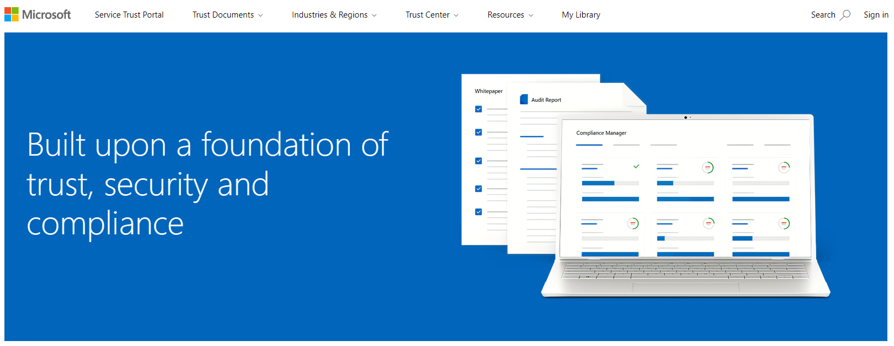
Service Trust portal
Notes:
https://learn.microsoft.com/training/modules/describe-features-tools-azure-for-governance-compliance/6-describe-purpose-of-service-trust-portal
The Microsoft Service Trust Portal is a portal that provides access to various content, tools, and other resources about Microsoft security, privacy, and compliance practices.
The Service Trust Portal contains details about Microsoft's implementation of controls and processes that protect our cloud services and the customer data therein. To access some of the resources on the Service Trust Portal, you must sign in as an authenticated user with your Microsoft cloud services account (Microsoft Entra organization account). You'll need to review and accept the Microsoft non-disclosure agreement for compliance materials.

Slide 12

Microsoft Purview
Microsoft Purview is a family of data governance, risk, and compliance solutions that helps you get a single, unified view into your data. Microsoft Purview brings insights about your on-premises, multicloud, and software as a service data together.
Automated data discovery
Sensitive data classification
End-to-end data lineage
Notes:
Azure Policy: https://learn.microsoft.com/en-us/purview/purview

Slide 13
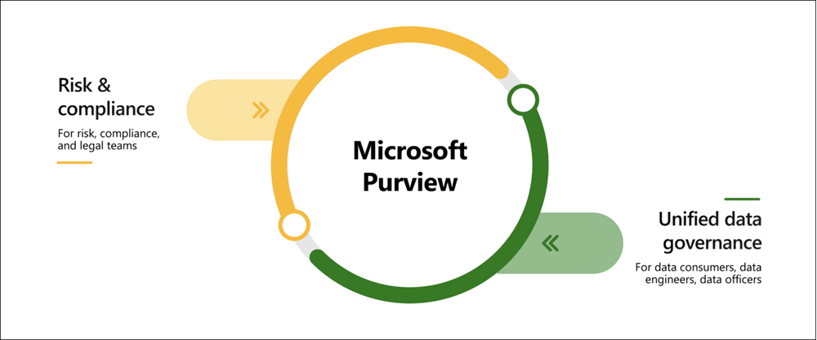
Microsoft Purview
Two main solution areas comprise Microsoft Purview: risk and compliance and unified data governance
Automated data discovery
Sensitive data classification
End-to-end data lineage

Slide 14
Cloud Adoption Framework
The Cloud Adoption Framework for Azure provides you with proven guidance to help with your cloud adoption journey. The Cloud Adoption Framework helps you create and implement the business and technology strategies needed to succeed in the cloud. The Cloud Adoption Framework consists of tools, documentation, and proven practices.
The Cloud Adoption Framework includes these stages:
Define your strategy.
Make a plan.
Ready your organization.
Adopt the cloud.
Govern and manage your cloud environments.

Slide 15
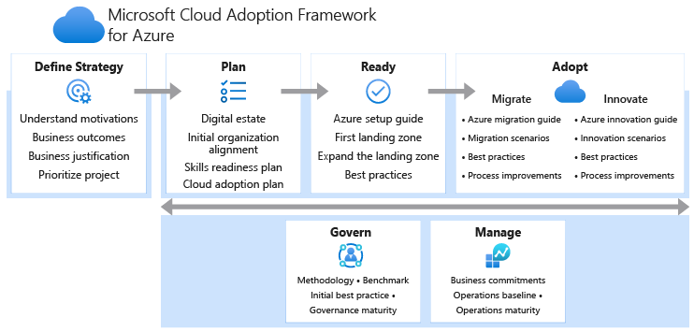
Cloud Adoption Framework

Slide 16
Define your strategy
Why you're moving to the cloud and what you want to get out of cloud migration.
Here are the steps in this stage:
Define and document your motivations:
Document business outcomes
Develop a business case
Choose the right first project

Slide 17
Make a plan
You build a plan that maps your aspirational goals to specific actions.
Here are the steps in this stage:
Digital estate
Initial organizational alignment
Skills readiness plan
Cloud adoption plan

Slide 18
Ready your organization
you create a landing zone, or an environment in the cloud to begin hosting your workloads.
Here are the steps in this stage:
Azure setup guide
Azure landing zone
Expand the landing zone
Best practices

Slide 19
Adopt the cloud
You begin to migrate your applications to the cloud.
Migrate: Here are the steps in the migrate part of this stage:
Migrate your first workload
Migration scenarios
Best practices
Process improvements
Innovate: Here are the steps in the innovate part of this stage:
Business value consensus
Azure innovation guide
Best practices
Feedback loops

Slide 20
Govern and manage your cloud environments
You begin to form your cloud governance and cloud management strategies.
Govern: Here are the steps in the govern part of this stage:
Methodology
Benchmark
Initial governance foundation
Improve the initial governance foundation
Manage: Here are the steps in the manage part of this stage:
Establish a management baseline
Define business commitments
Expand the management baseline
Advanced operations and design principles

Slide 21
Questions
What defines the set of controls that are recommended for resources within a specified subscription or resource group?
Select the correct option.
Symmetric policy
Secure score
Azure Policy
Asymmetric policy

Slide 22
Questions
2. If you want to prevent accidental deletion of an Azure resource, which of the following options should you use?
Select the correct option.
MFA
Azure Tags
Azure Resource Locks
Azure Policy

